Slide 1







Analysis on Emerging Technology Skills and Trends
Diego Serrano de Alba
24 October 2024

Slide 2









OUTLINE
Executive Summary
Introduction
Methodology
Results
Discussion
Conclusion
Appendix

Slide 3
EXECUTIVE SUMMARY
This report employs data analytics to emphasize current and future trends in demand for skills in programming languages, databases, and other technologies. It also examines the demographic profiles of technology sector professionals.
This report employs data analytics to emphasize current and future trends in demand for skills in programming languages, databases, and other technologies. It also examines the demographic profiles of technology sector professionals.
The findings showed that:
Javascript is currently the most popular programming language and is anticipated to be so in the future.
MySQL has the highest database usage at the moment.
Postgre SQL is projected to have more demand in the future.

Slide 4
INTRODUCTION
This presentation report uses data analytics to highlight current and potential trends in the technological industry related with skills in programming, databases, platforms and web frames.
The three research inquiries of the research are the following:
1. Which programming languages are most in demand today?
2. What are the most in-demand database skills?
3. What popular IDEs or Web frames are there?
The target audience for this research are IT professionals, business analysts, STEM graduates, and anybody who wants to learn about the top on-demand IT skills in their respective sectors that will still be relevant in the future.

Slide 5
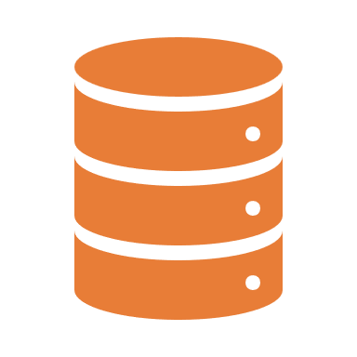



METHODOLOGY
With Python, Data analysis processes have provided insights to measure tendencies by eliminating outliers, running variable correlations, or checking the robustness of the mentioned correlations.
Finally, demographic information, such as Age, Countries, Gender or education level has been examined.
Data collection has been gathered from the 2019 Stack overflow using tools, such as APIs or Webscraping, in order to collect all the necessary information.
Data cleaning processes, such as removing duplicates, imputing missing values, and normalizing data, have been applied to make the information actionable with the use of SQL and Python.
With Python, Data analysis processes have provided insights to measure tendencies by eliminating outliers, running variable correlations, or checking the robustness of the mentioned correlations.
Finally, demographic information, such as Age, Countries, Gender or education level has been examined.
Data visualizations, using Python and Cognos analytics, have offered a visual understanding of the IT tendencies with the help of charts, graphs, pivot tables or dashboards.
Data visualizations, using Python and Cognos analytics, have offered a visual understanding of the IT tendencies with the help of charts, graphs, pivot tables or dashboards.

Slide 6
RESULTS

Slide 7
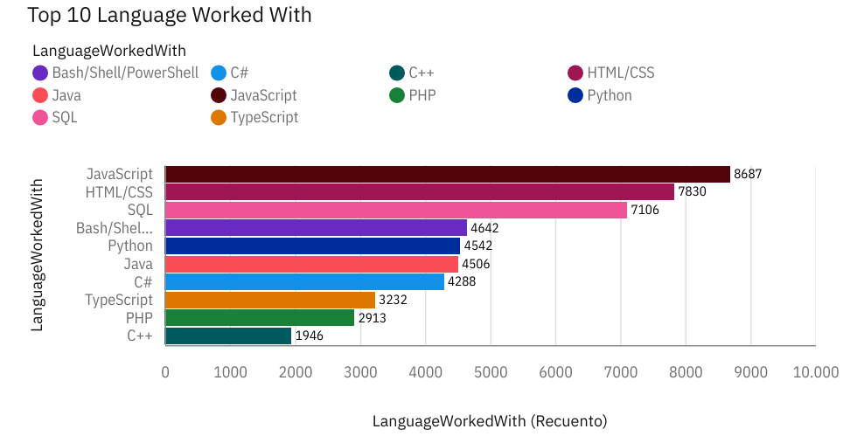
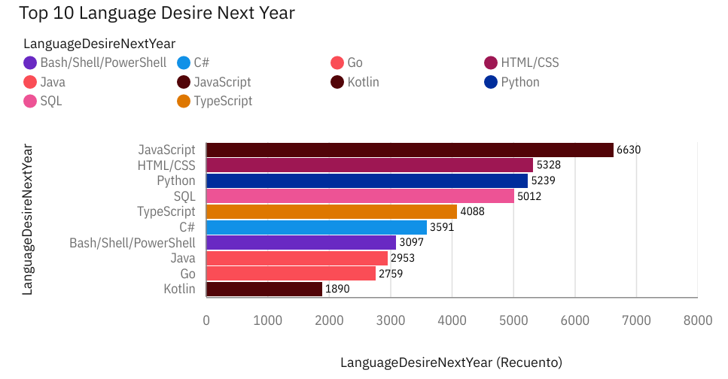
PROGRAMMING LANGUAGE TRENDS
Current Year
Next Year

Slide 8
PROGRAMMING LANGUAGE TRENDS - FINDINGS & IMPLICATIONS
Findings
JavaScript, HTMLS and SQL and Python are the most promising languages. Big increase of TypeScript.
PHP and C++ will exit from the top.
TypeScript and Python are the most increasal ones. Go and Kotlin will start appearing in the top.
Implications
Python will continually increase its tendency due to AI and ML situations nowadays, but also due to the data and science analysis possibilities.
JavaScript and HTML will continue to be the most used for web development and hard programming, diminishing certain expectations about the impact of AI on the disappearance of big programming programs.
SQL will remain the most important one to data professionals.

Slide 9
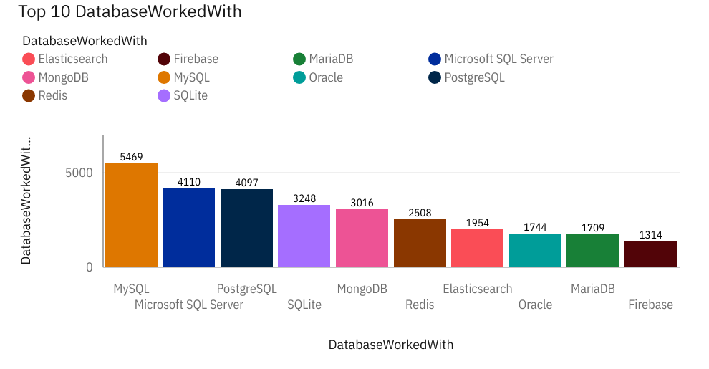
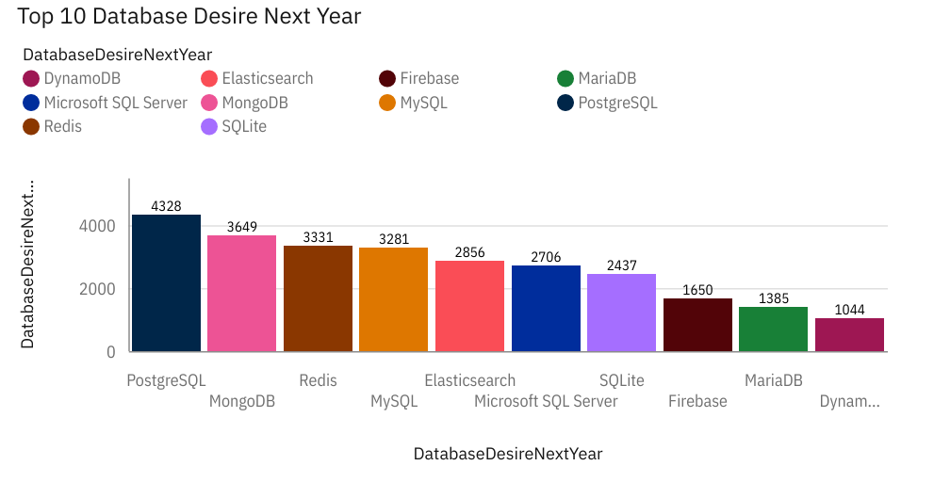
DATABASE TRENDS
Current Year
Next Year

Slide 10
DATABASE TRENDS - FINDINGS & IMPLICATIONS
Implications
The best datasets are SQL-related, MongoDB, and Redis.
SQL will remain a top database tool, although it will lose its place as the indisputable Top 1 database tool.
Open-source datasets will increase their popularity.
Findings
SQL will lose a big relevance on database trends, maintaining at the same time the top position with PostgreSQL.
MongoDB and Redis have high expectations of increasing and entering the top 3.
Redis and Elasticsense are relatively new tools and are expected to gain big traction in the IT space.

Slide 11
DASHBOARD
https://github.com/Diego-Serrano01/IBM-data-analysis/blob/253cb53dbdb5814906f88d7e69bd74c629c2c7b1/5.%20IBM%20Cognos%20Analytics%20Capstone.pdf

Slide 12
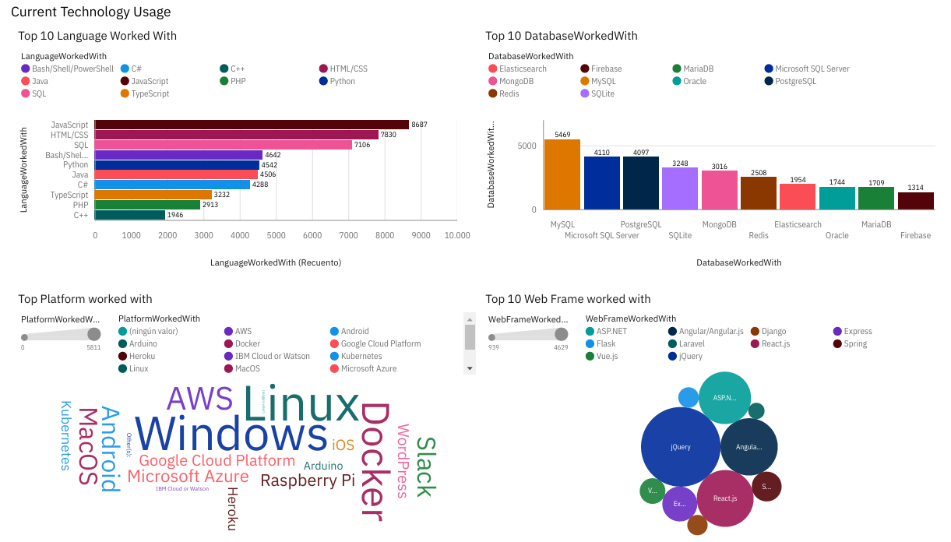
DASHBOARD TAB 1

Slide 13
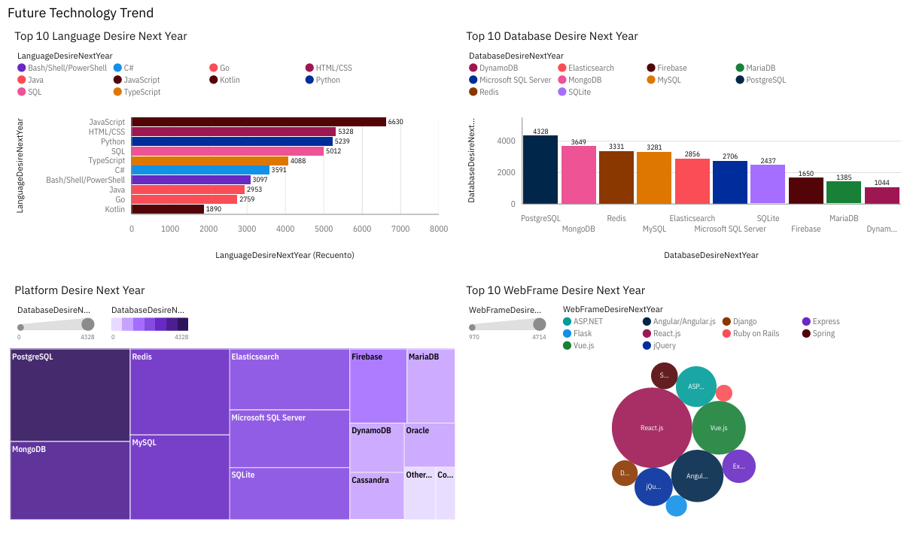
DASHBOARD TAB 2

Slide 14
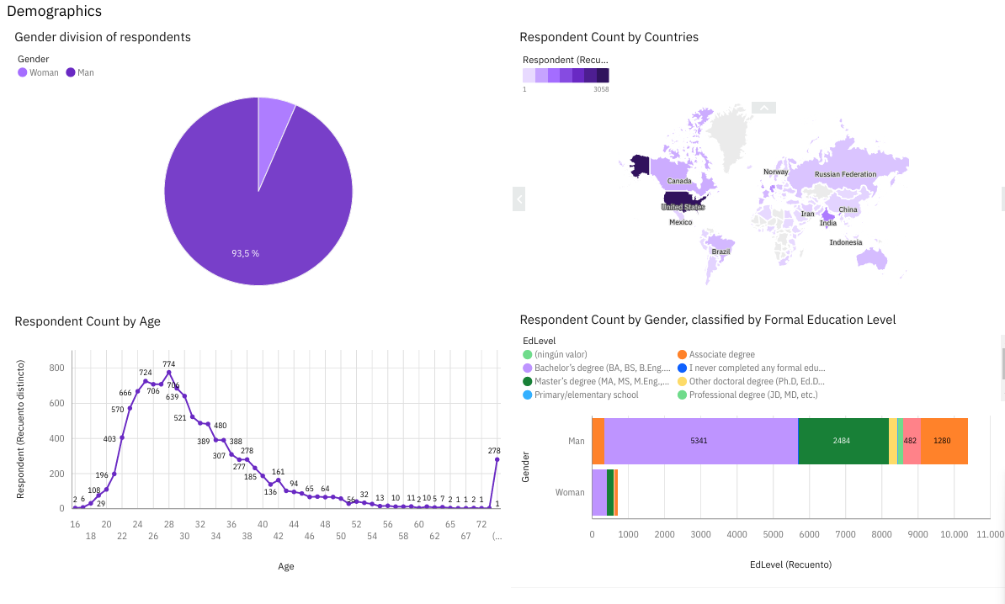
DASHBOARD TAB 3

Slide 15
DISCUSSION
Males occupy almost the entire IT tech. industry.
The relevance of being constantly updated in the tech industry. Programs or databases are not in a static position, although the most important programming and databases programs will continue being the same in a short/mid-term.
High programming abilities are still essential, although many user-friendly, open-source languages and programs are appearing due to the increase in the demand sector.
Although most of the users have a bachelors degree, the opportunities for non-STEM careers are increasing, and doing a PhD is a requisite only for high specialized areas and jobs, which specially apply to the STEM sector.
The average Annual salary remains constantly good. However, Python, JavaScript, Swift and C++ are the better ones. Other ones with high popularity, like SQL, are worse paid compared to their amount of use.

Slide 16
CONCLUSION
The data analysis industry is expanding its horizons, creating new niches in the market constantly. Therefore, although the tech industry has always had high costly entrance, the present situation reveals the need for a constant update in new IT skills and a high-level education or high specialization.

Slide 17
APPENDIX

Slide 18
JOB POSTINGS

Slide 19
POPULAR LANGUAGES

